Slide 1
Final Fantasy XIV - Practical project
22AprEnable1
By Jasmin Willis

Slide 2
Project introduction
Project Objectives:
To create a fully functional CRUD application with a front-end and back-end.
I chose to do my project on Final Fantasy XIV as characters can have more than one job.
The MVP:
Jira scrum board for project management.
ERD(s)
Risk assessment
Version source control with FBM.
At least 2 entities in a relational database.
A functional application front-end which connects to the back-end API.
Code ran through SonarQube and fully designed test suites

Slide 3
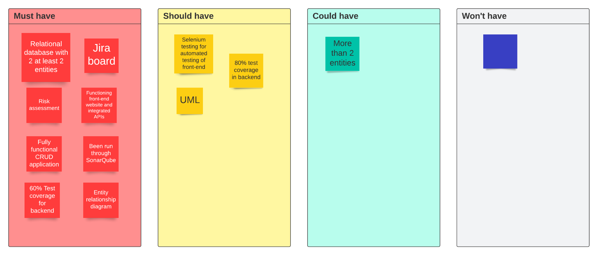
MoSCoW

Slide 4
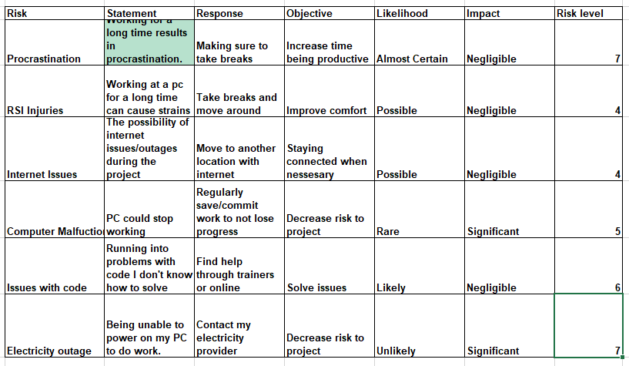
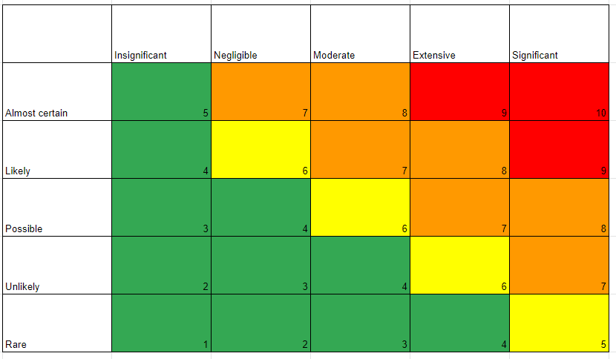
Risk Matrix

Slide 5
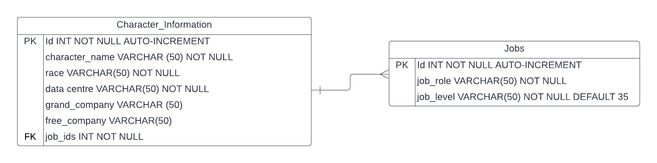
Entity Relationship Diagram - Initial

Slide 6
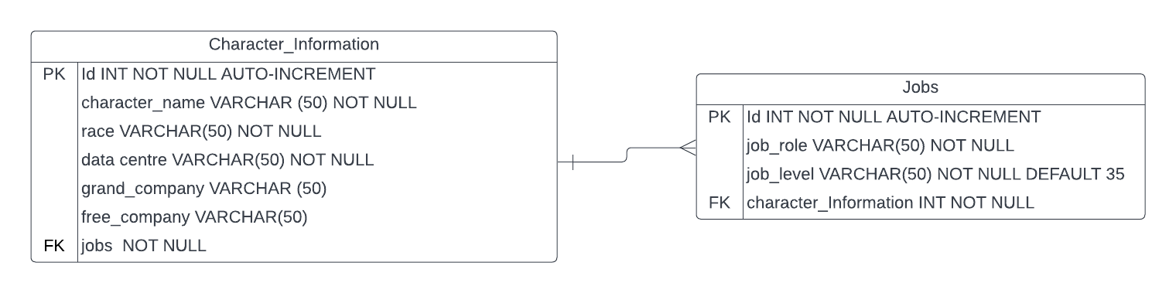
Entity Relationship Diagram - After completion

Slide 7
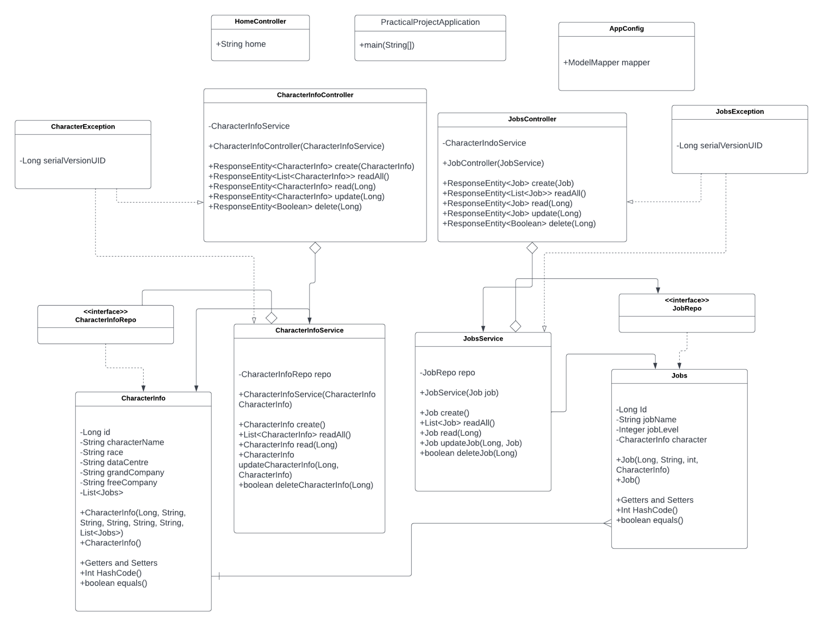
UML diagram

Slide 8
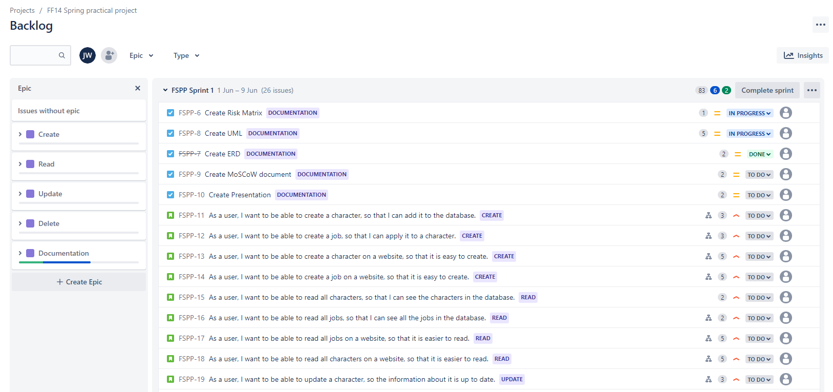
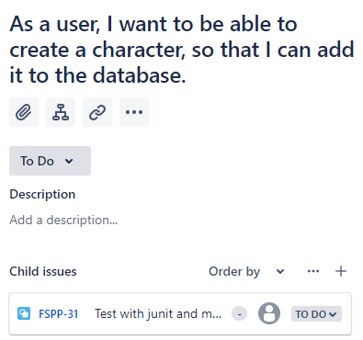
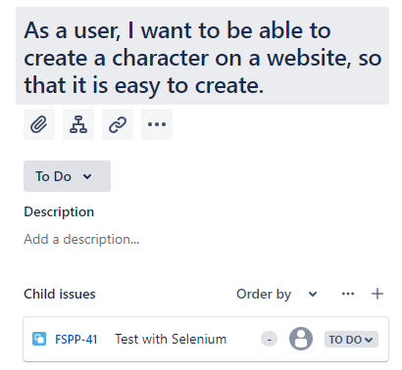
Jira Board - 1 week sprint

Slide 9
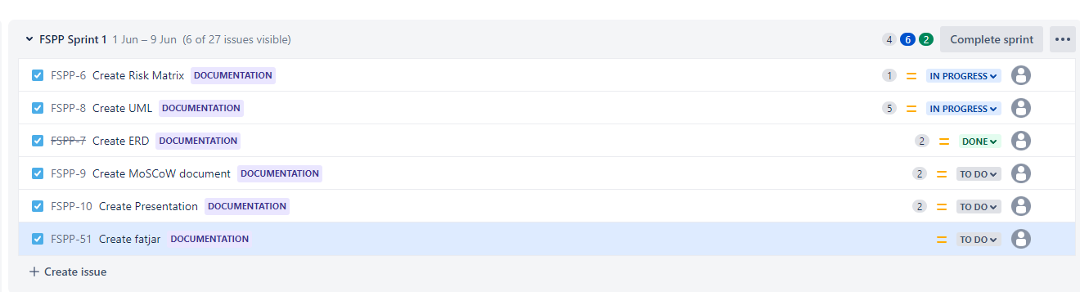
Jira Tasks

Slide 10
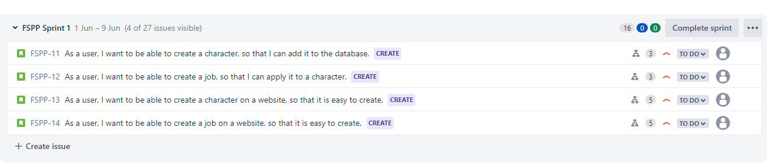
Jira - User Stories

Slide 11
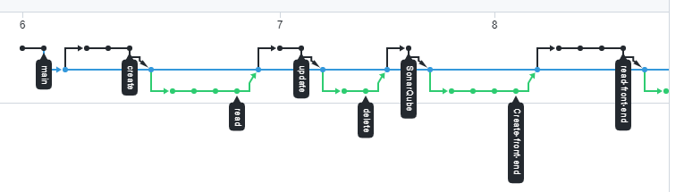
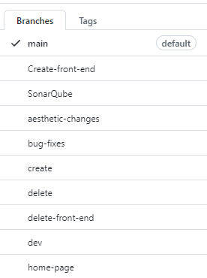

Github

Slide 12
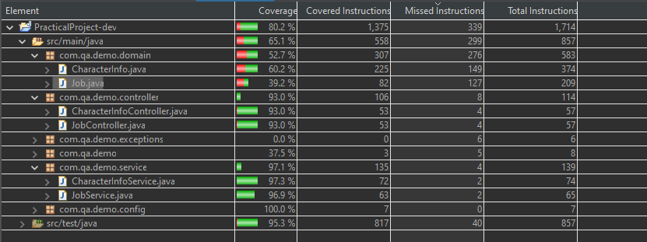
Test Coverage

Slide 13
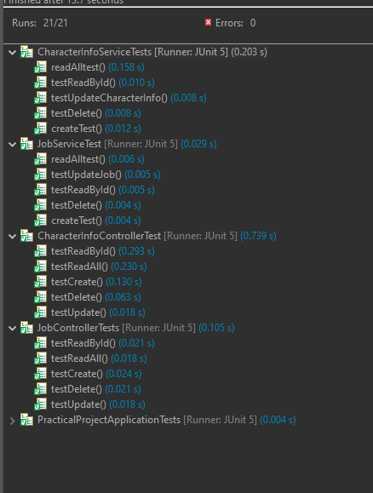
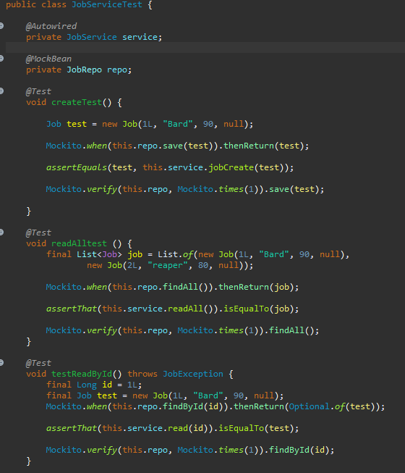
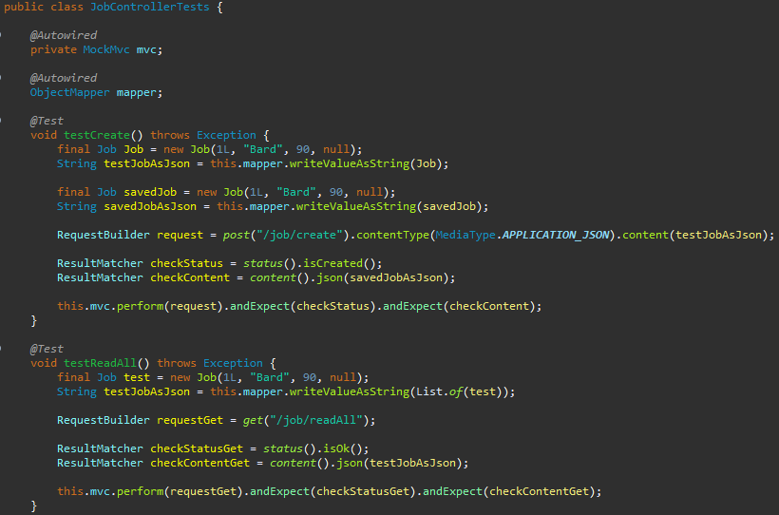
Unit and Integration Testing

Slide 14
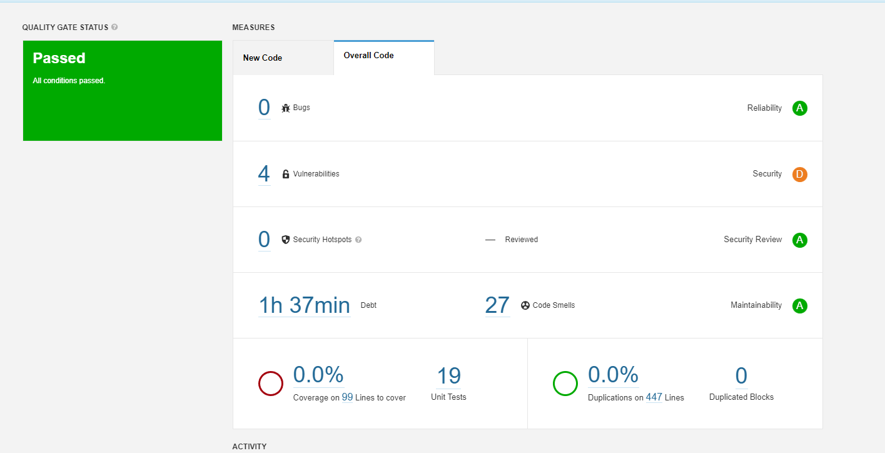
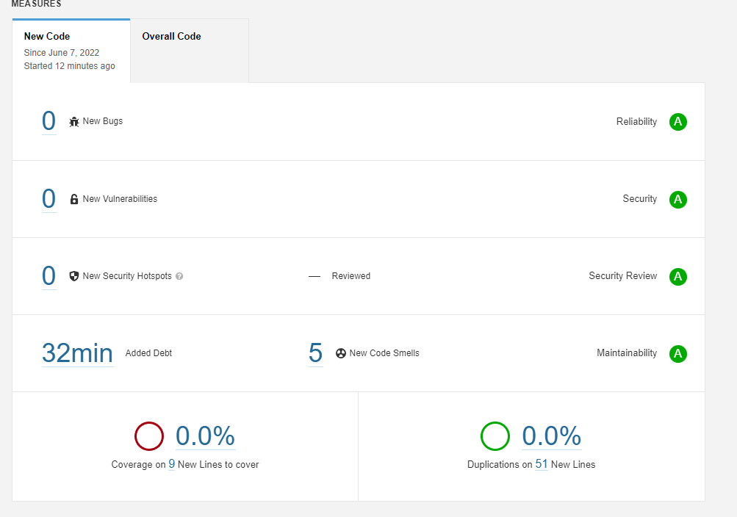
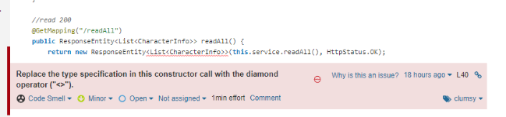
SonarQube

Slide 15
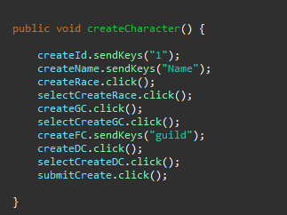
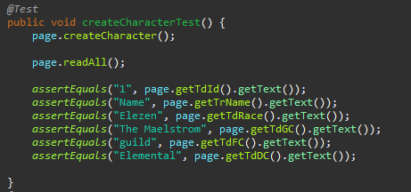
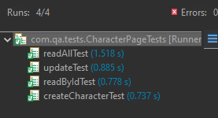
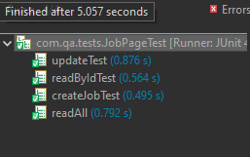
Selenium Testing

Slide 16
Demo

Slide 17
Sprint Review
What went well:
Testing!
Using version source control
Using HTML, CSS and JavaScript
What didn’t go so well:
Also testing - lombok wasn’t working and was causing my tests to fail.
Front-end still looks a bit messy and could use some extra features.
What I can learn going forward:
I have a better estimation of my skills and the time it takes to do certain tasks.
Practice more!

Slide 18
Thank you for listening!

